Slide 1
Fun in Shanghai
Michelle

Slide 2
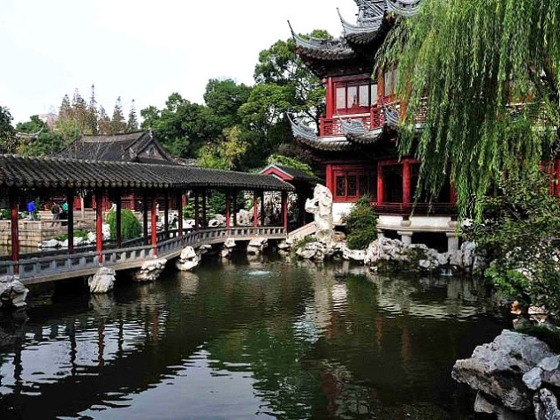
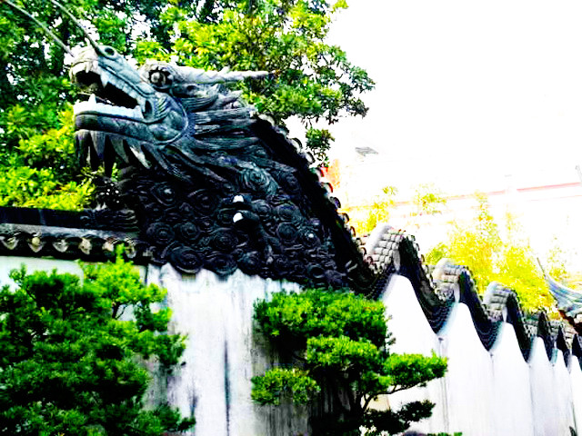
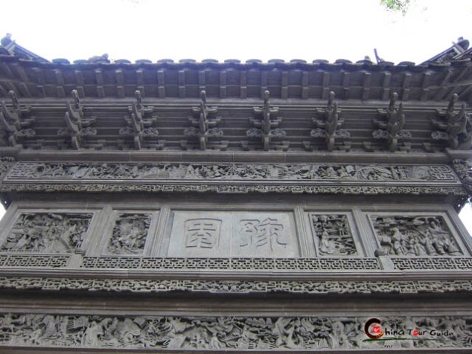
1. Yuyuan Garden
Before you go into Yu garden, you can see a lot of old Chinese buildings. These buildings are all restaurant or stores.
In Yu gardens, there are beautiful houses, grottoes, pavilions, and lotus ponds.
It was built in 1577.
Fee: 40 RMB

Slide 3
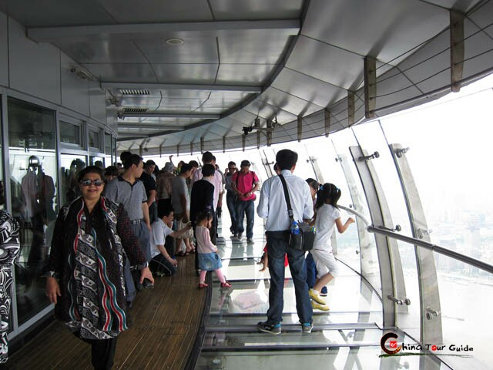
2. Oriental Pearl Tower
-SHANGHAI, PUDONG
Hanging Sightseeing Floor
Oriental Pearl Tower is the 5th tallest tower in the world. In this tower, the most important floor is the sightseeing glass floor. From this floor, you can see all of Shanghai.
Fee: Free

Slide 4
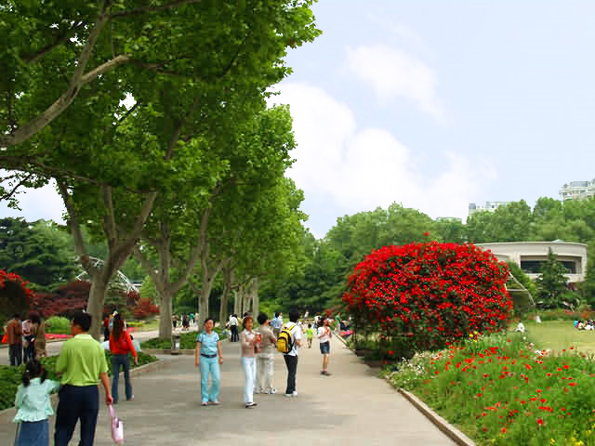
3. Shanghai Zoo
In this zoo the most famous animal is the panda. They also have monkeys, tigers, kangaroo, chimpanzees, and polar bears.
There are also lakes and grass that you can eat your lunch.
There is also an amusement park at the zoo.

Slide 5
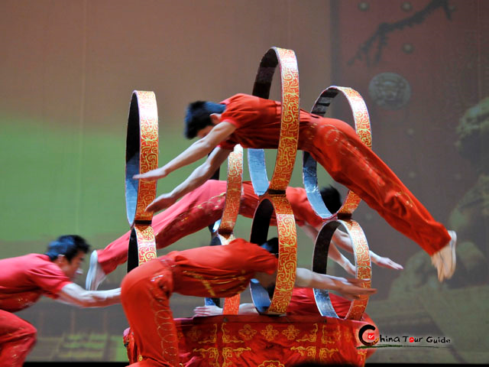
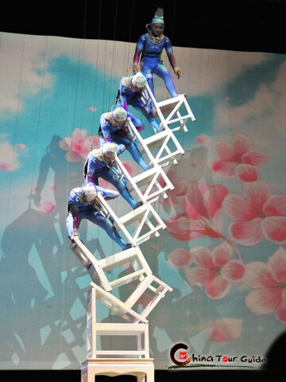
4. Acrobatics Show
Chinese Acrobatics is one of the oldest performing arts in
China
Ticket: USD 34, CNY 211

Slide 6
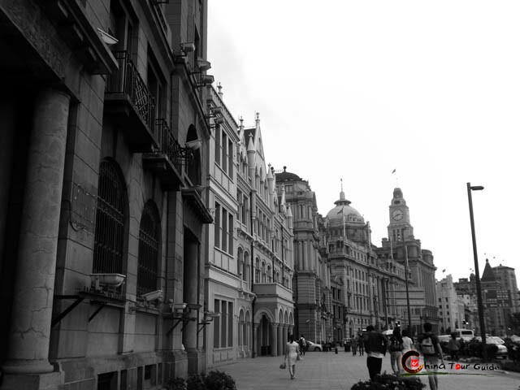
5. The Bund Contrast of the Old and the New Shanghai
There are many beautiful buildings on the Bund. These buildings are built in a European style. There are many different styles. It is located beside the river. I think that it is more beautiful if you visit the Bund at night.

Slide 7
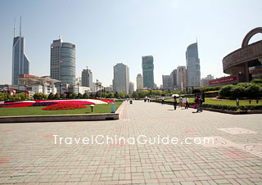
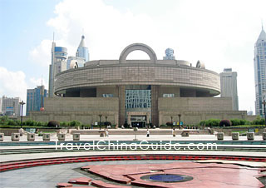
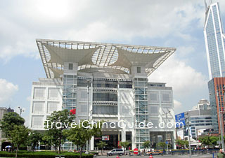
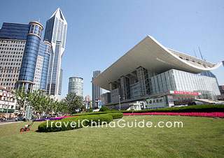
6.People’s square
ShanghaiMuseum
Urban planningExhibition Hall
Grand Theater

Slide 8
People’s square is in the centre of the city.
There are many museums in People’s square. The Urban planning museum is a famous museum.
In the urban planning museum you can see a model of all of Shanghai. On the model, you can see what the city will look like in 2020.
Admission fee: free

Slide 9
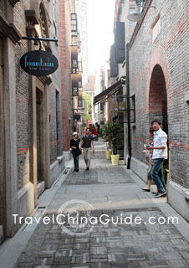
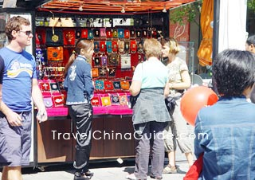
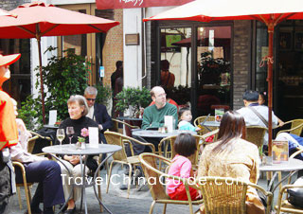
7. Xin tian di
Xintiandi is like Tianzifang. It has buildings that look old. There are many shops to buy things. There are also a lot of nice restaurants with food from different countries. It is very fashionable.

