Slide 1
Tourist Attractions In Karachi
Presentation by: Hamza Khalid and Shahrukh Adil

Slide 2
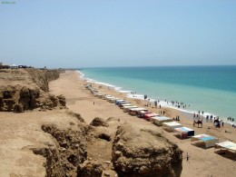
The Hawkes bay Beach
Karachi is a beaching heaven. With its shiny sunny beaches, Karachi is one of the most popular beach cities in the world. The relatively mild climate and the sunny days makes the experience much more amazing.

Slide 3
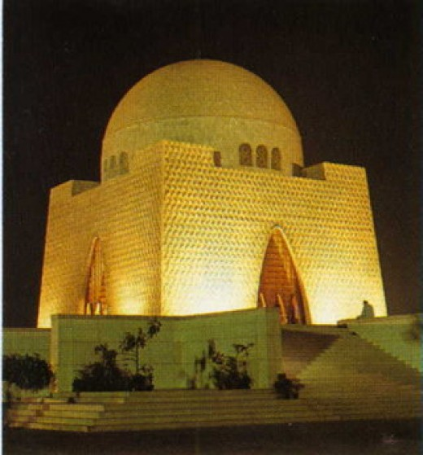
Quaid-e-Azam’s Mausoleum
One of the most important landmarks in the city of Karachi is the Mausoleum of the Quaid e Azam (the Great Leader) Muhammad Ali Jinnah. The city is also the birth place of the Nation's founder whose splendid white marbled mausoleum towers the skies of Karachi

Slide 4
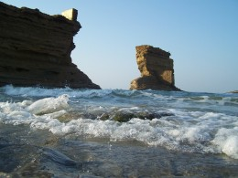
Paradise Point
The Paradise Point attracts visitors with its rock promontory and a natural rock arch. Discover underwater world with scuba diving. To boil it all up, you can't resist the charm of these beaches if you're a coastal vulture.

Slide 5
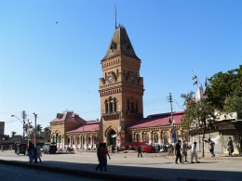
Empress Market
The market traces its origins to the British Raj era, when it was first constructed. Today, it is amongst the most popular and busy places for shopping in Karachi and reflects as one of the few historical spots of the city. Commodities sold in the Empress Market range from condiments, fruit, vegetables and meat to stationary material, textiles and pet shops.

Slide 6
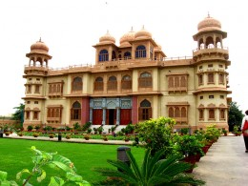
Mohatta Palace
The architect of the palace was Agha Ahmed Hussain. However, Mohatta could enjoy this building for only about two decades before the independence, after which he left Karachi for India. He built the Palace in the tradition of stone palaces in Rajasthan, using pink Jodhpur stone in combination with the local yellow stone from Gizri.

Slide 7
THANK YOU!!!!

